Slide 1
Broadcast((p2mp) and point to point networks
Broadcast mode of communication is a communication in which large number of receivers are linked to a single transmitter. Examples of such a system are radio, television.
on a broadcast network, the communication channel is shared by all the machines on the network; packets sent by any machine are received by all the others.

Slide 2
Point to point mode of communication is a communication over a link between a single transmitter and receiver. Example of such a system is a telephone.
. Point-to-point links connect individual pairs of machines. To go from the source to the destination on a network made up of point-to-point links, short messages, called packets in certain contexts, may have to first visit one or more inter- mediate machines. Often multiple routes, of different lengths, are possible, so finding good ones is important in point-to-point networks. Point-to-point transmission with exactly one sender and exactly one receiver is sometimes called unicasting.

Slide 3
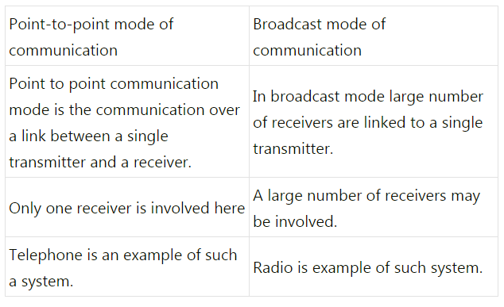
Differences between

Slide 4
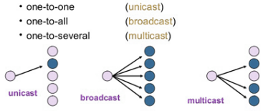
Data is transported over a network by three simple methods i.e. Unicast, Broadcast, and Multicast. So let’s begin to summarize the difference between these three:
Unicast: from one source to one destination i.e. One-to-One
Broadcast: from one source to all possible destinations i.e. One-to-All
Multicast: from one source to multiple destinations stating an interest in receiving the traffic i.e. One-to-Many.
A simple example of multicasting is sending an e-mail message to a mailing list. Teleconferencing and videoconferencing also use multicasting

Slide 5
Modes of transmission
What is data transmission?
Data transmission refers to the process of transferring data between two or more digital devices. Data is transmitted from one device to another in analog or digital format. Basically, data transmission enables devices or components within devices to speak to each other.
There are two methods used to transmit data between digital devices: serial transmission and parallel transmission. Serial data transmission sends data bits one after another over a single channel. Parallel data transmission sends multiple data bits at the same time over multiple channels.

Slide 6
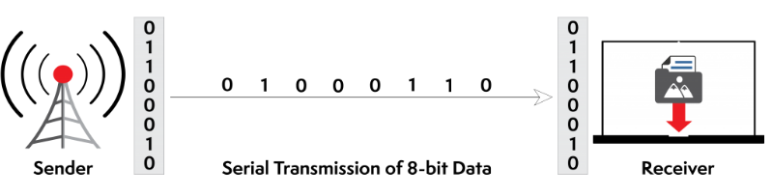
What is serial transmission?
When data is sent or received using serial data transmission, the data bits are organized in a specific order, since they can only be sent one after another. The order of the data bits is important as it dictates how the transmission is organized when it is received. It is viewed as a reliable data transmission method because a data bit is only sent if the previous data bit has already been received.

Slide 7
Serial transmission has two classifications: asynchronous and synchronous.
Asynchronous Serial Transmission Data bits can be sent at any point in time. Stop bits and start bits are used between data bytes to synchronize the transmitter and receiver and to ensure that the data is transmitted correctly. The time between sending and receiving data bits is not constant, so gaps are used to provide time between transmissions.
The advantage of using the asynchronous method is that no synchronization is required between the transmitter and receiver devices. It is also a more cost effective method. A disadvantage is that data transmission can be slower, but this is not always the case.
Synchronous Serial Transmission Data bits are transmitted as a continuous stream in time with a master clock. The data transmitter and receiver both operate using a synchronized clock frequency; therefore, start bits, stop bits, and gaps are not used. This means that data moves faster and timing errors are less frequent because the transmitter and receiver time is synced. However, data accuracy is highly dependent on timing being synced correctly between devices. In comparison with asynchronous serial transmission, this method is usually more expensive.

